Slide 1

Smartgate+
AWS
architecture
Visualization Layer
Web Hosting
UI React JS
API – .NET
Data Processing layer
Data Processing Services .NET
Database
MS SQL/PostgreSQL
Flat file
Data Acquisition layer
Data Logger
OPC UA Client (.NET)
Production Units
PLC with OPC UA Server

Slide 2
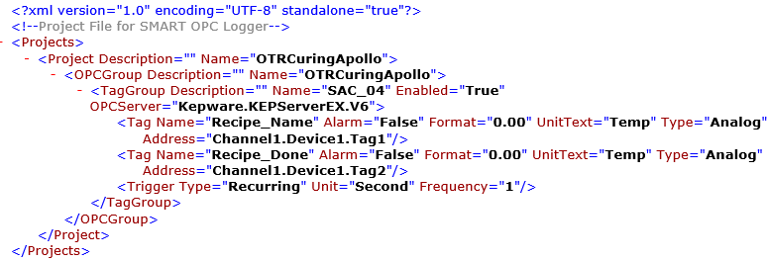

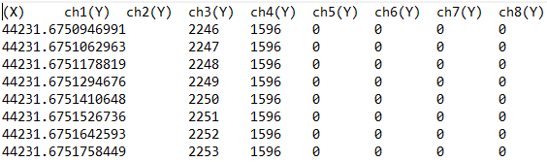
Smartgate+
ARCHITECTURE - Data Logger
Configuration in XML
[OPC Server]
[Data Logger]
OTRCuring
SAC_04
04Feb21B

Slide 3

Smartgate+
ARCHITECTURE - Data Processing Service
Item List
BOM with Cycle time
Plant, Area & Equipment
Operator List
Logic
Parameter condition
Downtime detection
Cycle time Identification
Master
[Data Logger]
[Data Processor]
Information
OTRCuring
SAC_04
04Feb21B
Raw Data

